Slide 1
第2章
整数规划

Slide 2
目录 CONTENTS
01
整数规划问题
02
整数规划模型求解
03
比赛项目排序问题

Slide 3
01
整数规划问题

Slide 4


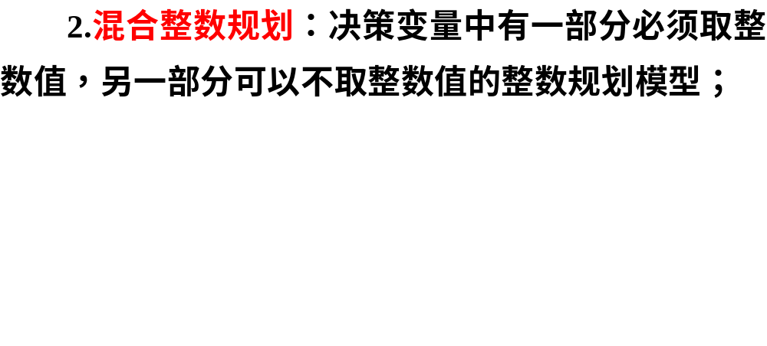
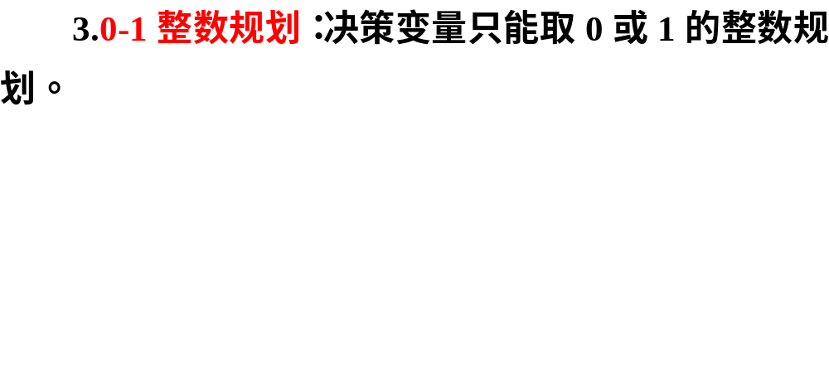
2.1.1 整数线性规划模型及问题

Slide 5

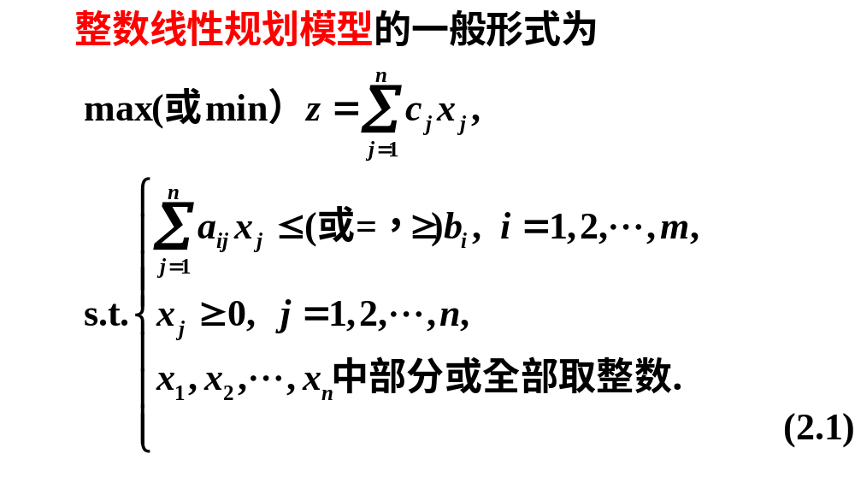

Slide 6
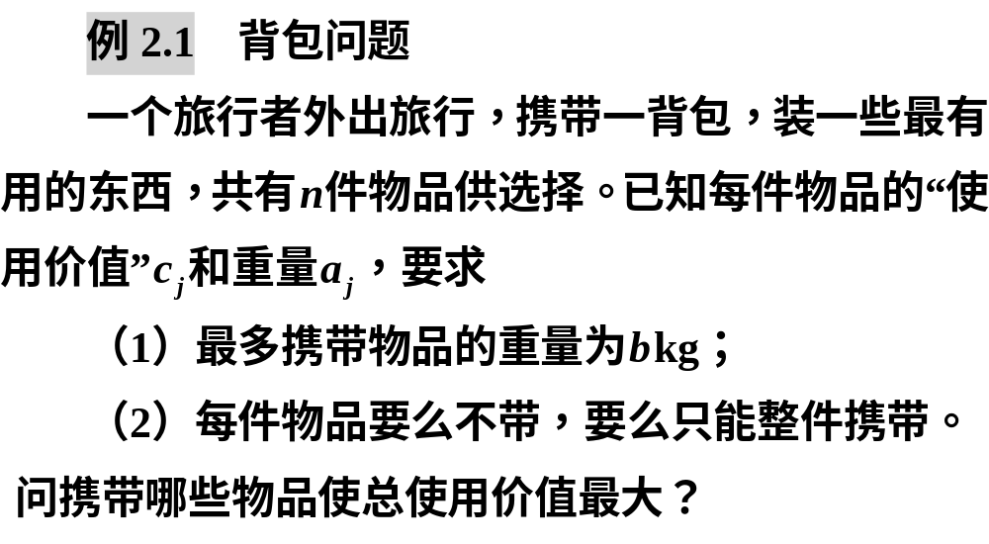

Slide 7


Slide 8
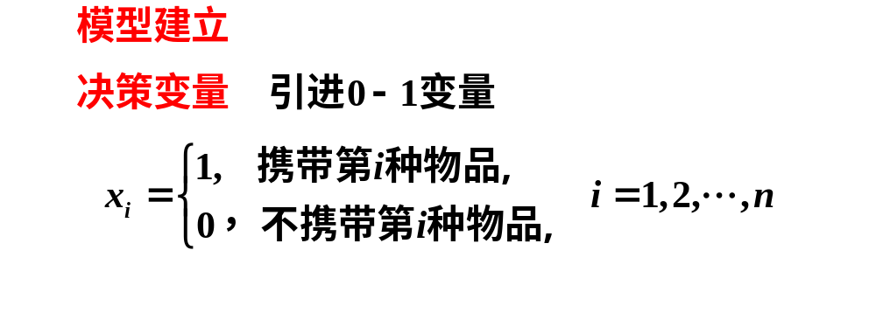


Slide 9
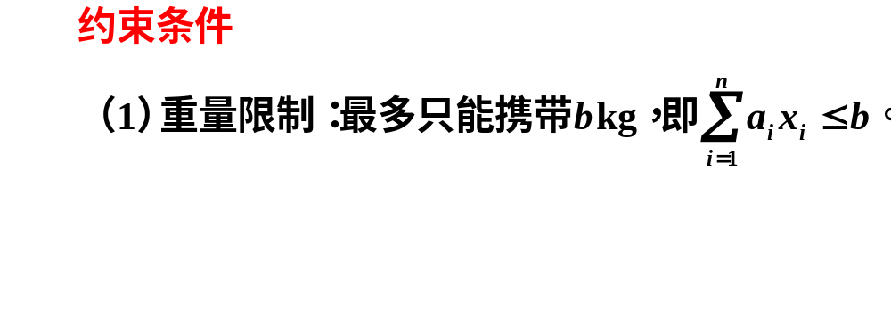
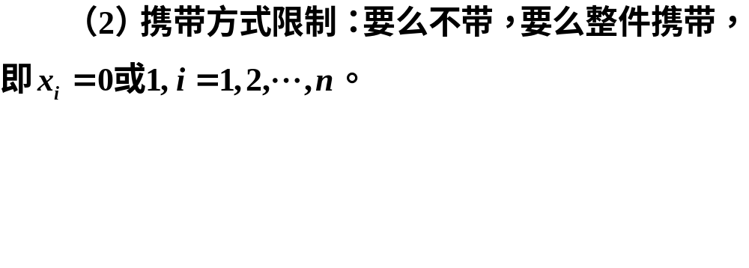

Slide 10
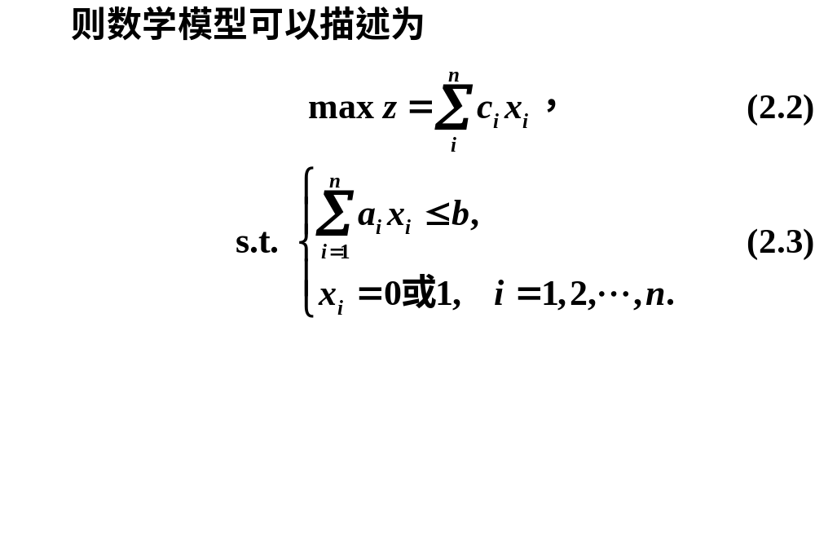

Slide 11
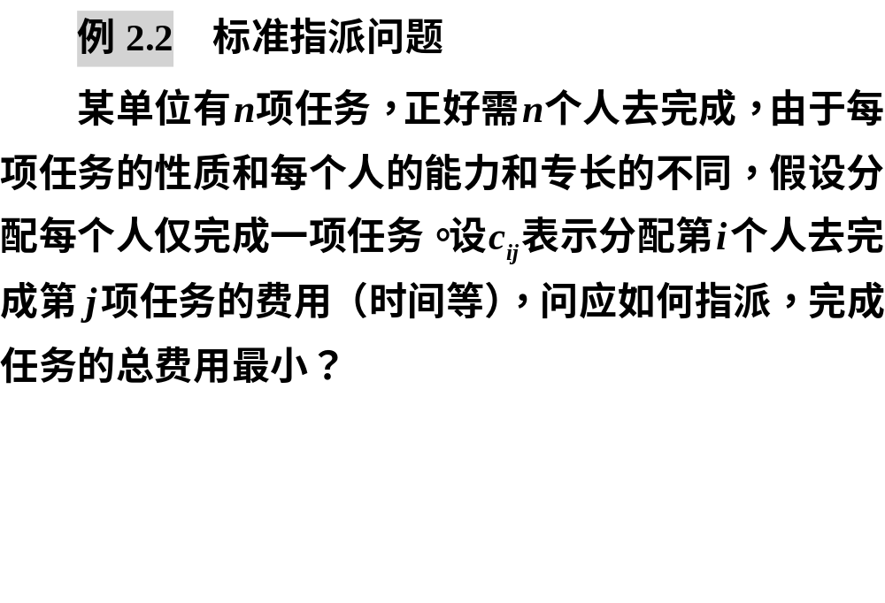

Slide 12
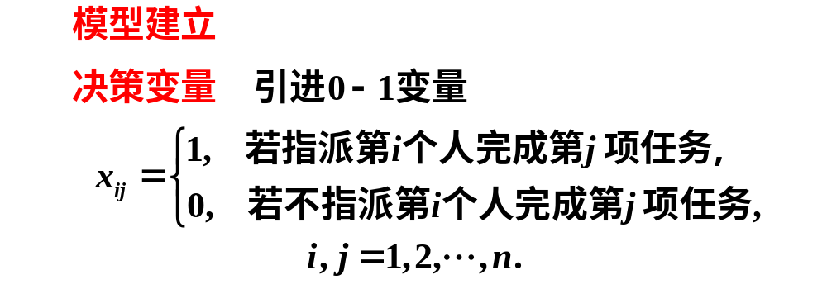
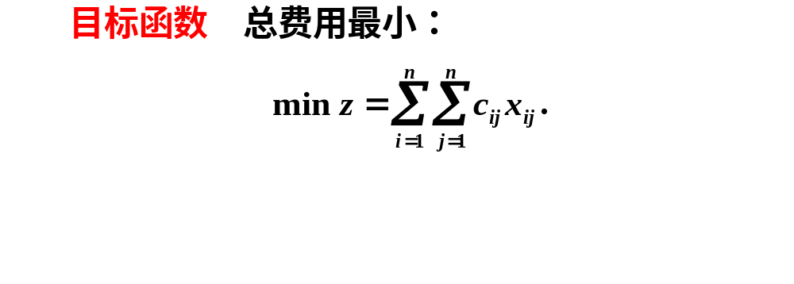

Slide 13
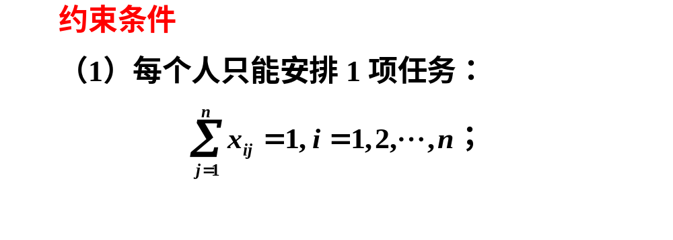
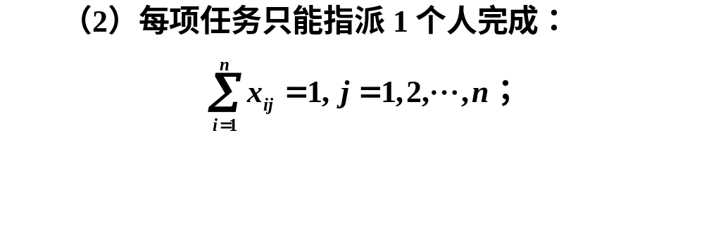
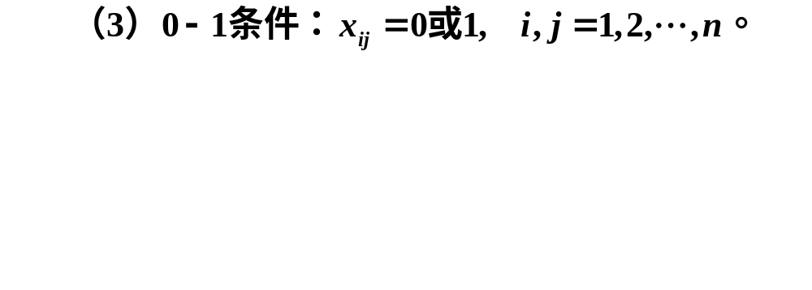

Slide 14
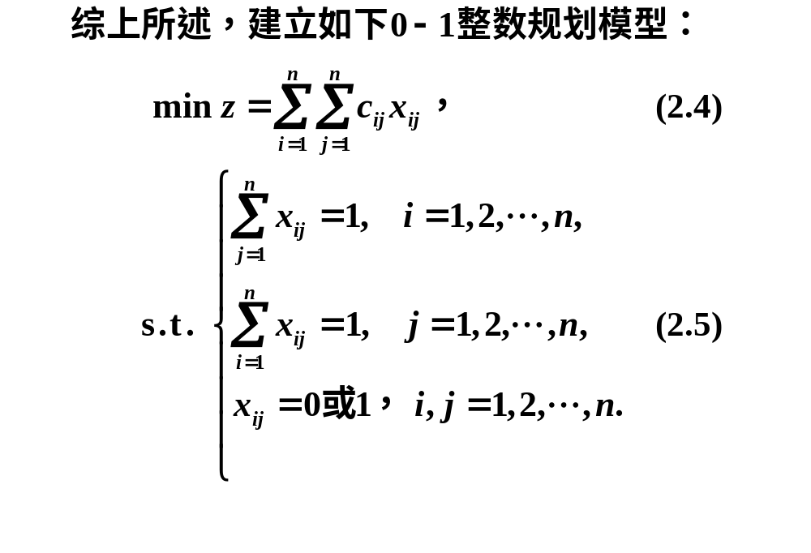

Slide 15
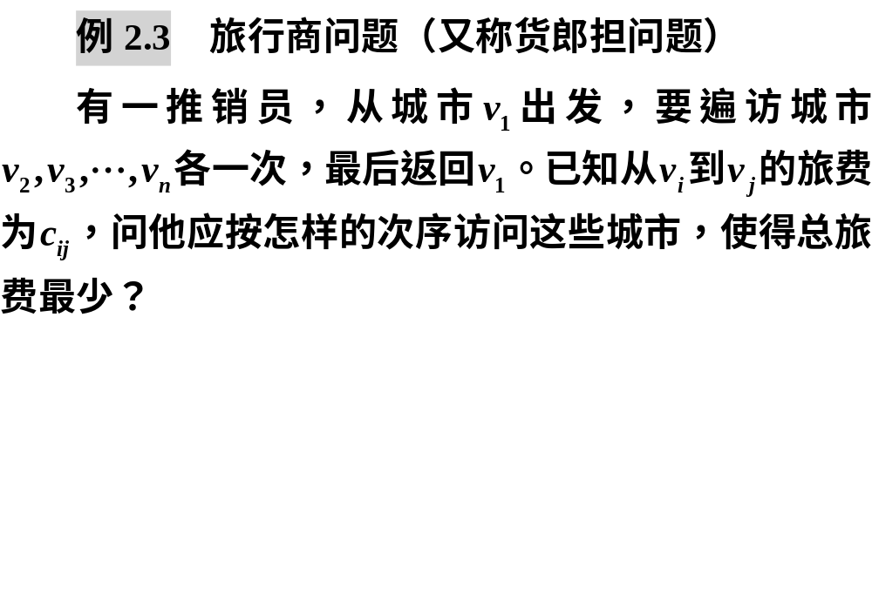

Slide 16

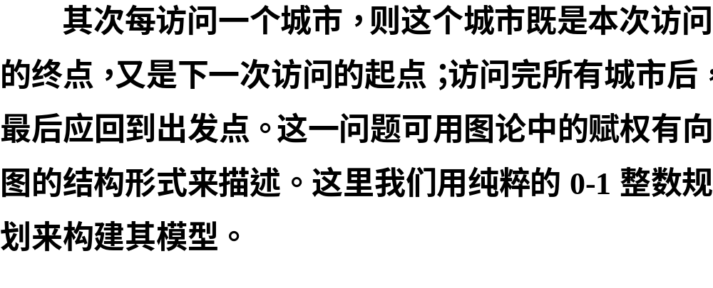

Slide 17
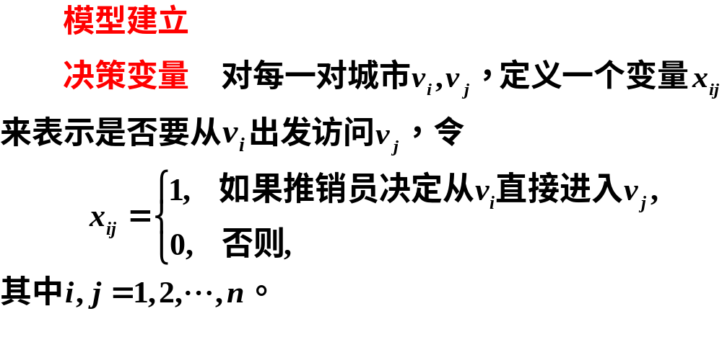

Slide 18
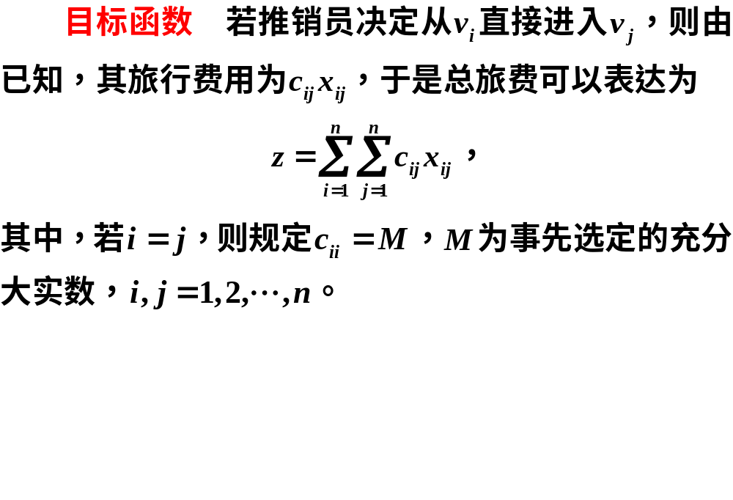

Slide 19
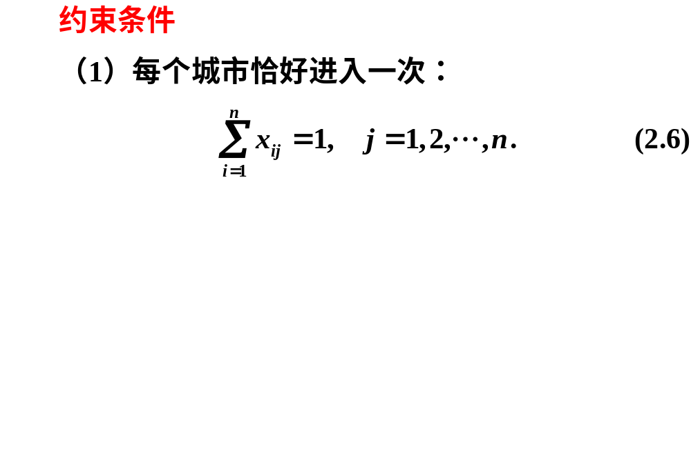
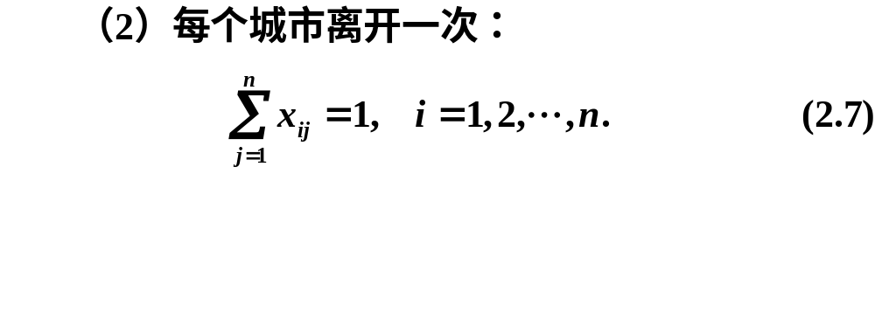

Slide 20
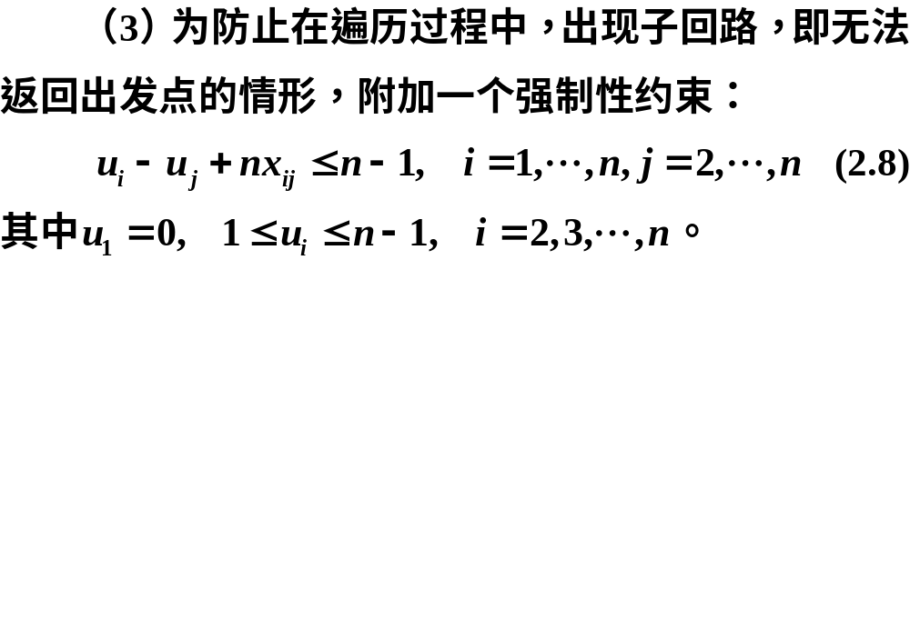

Slide 21
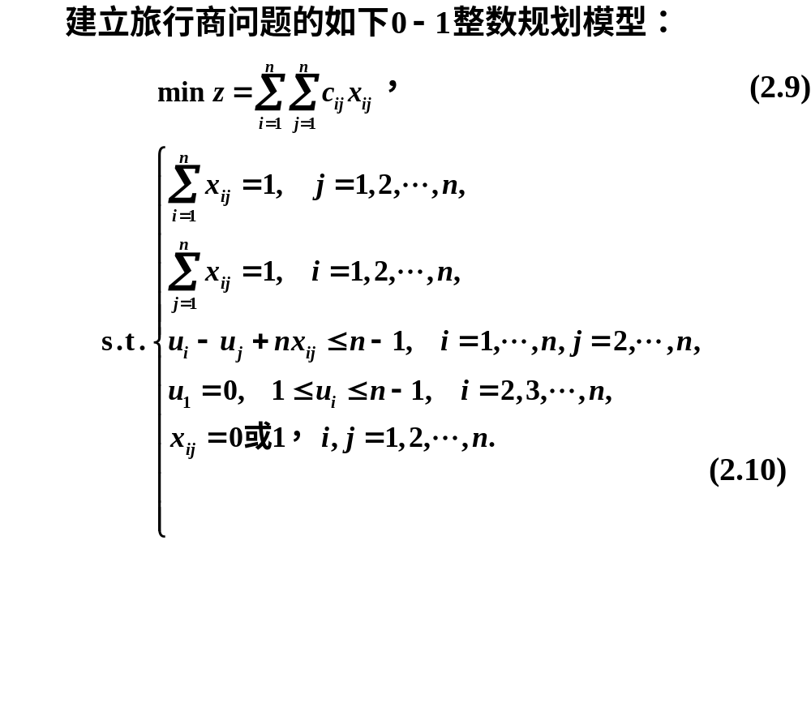

Slide 22


Slide 23
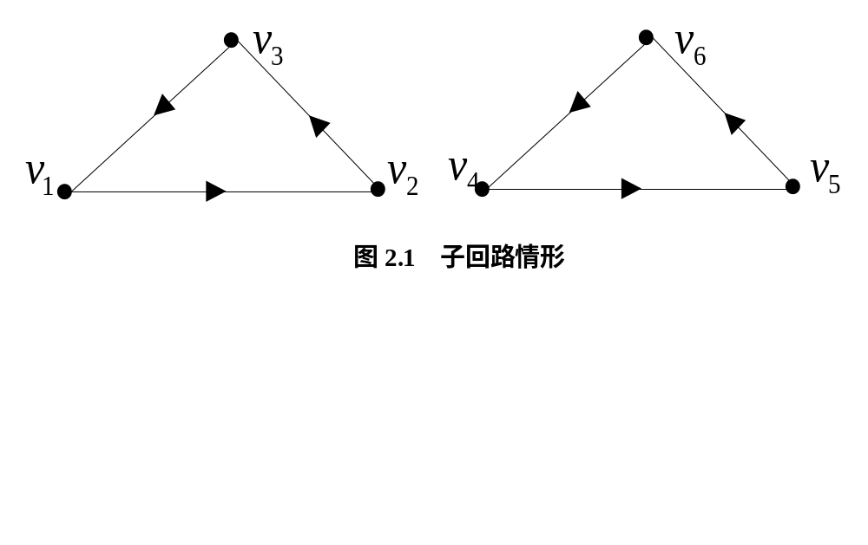
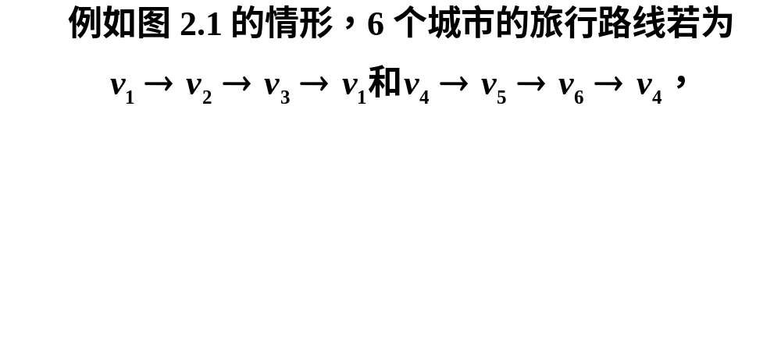

Slide 24
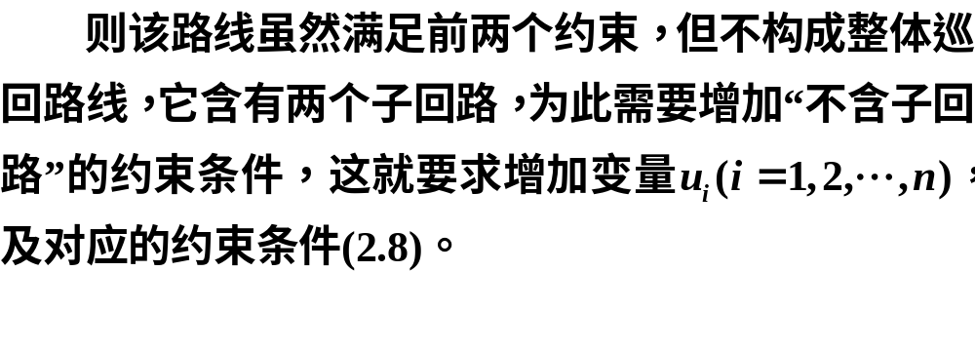

Slide 25
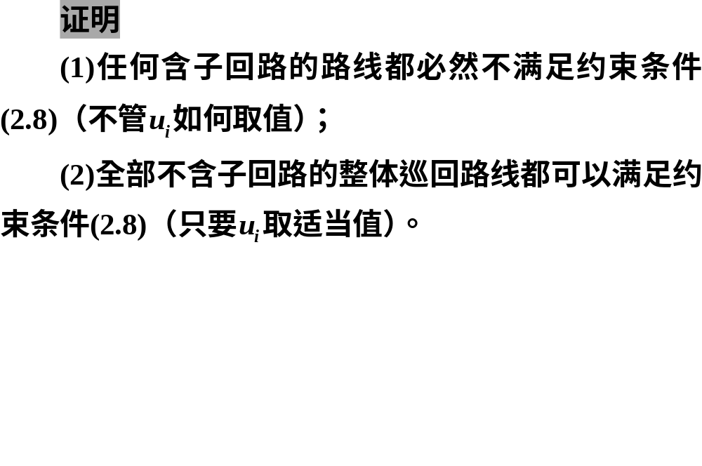

Slide 26

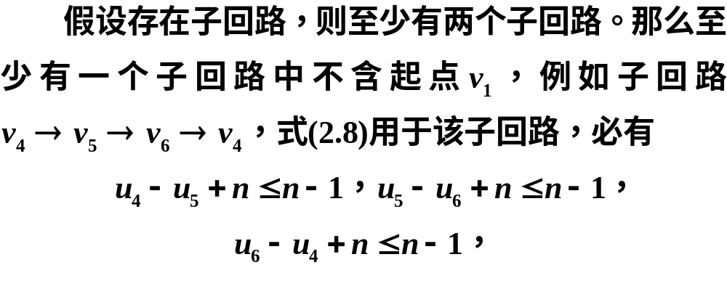

Slide 27
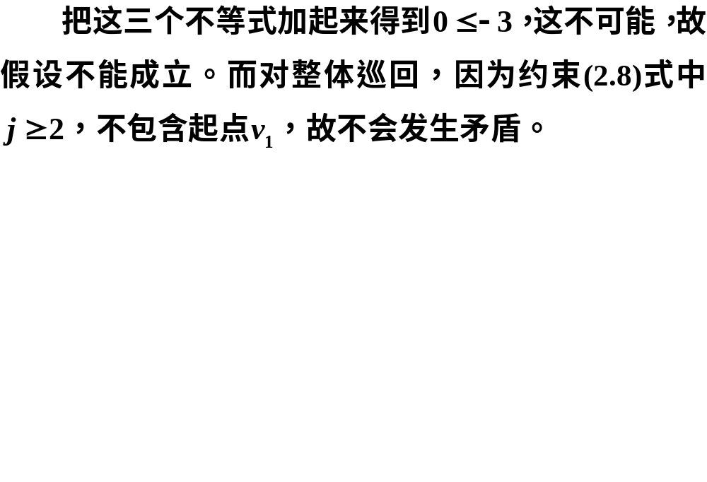

Slide 28
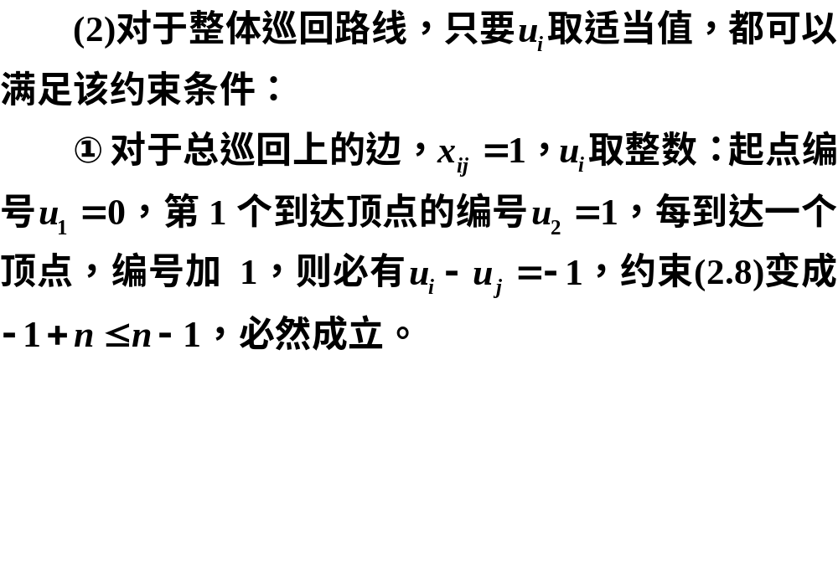
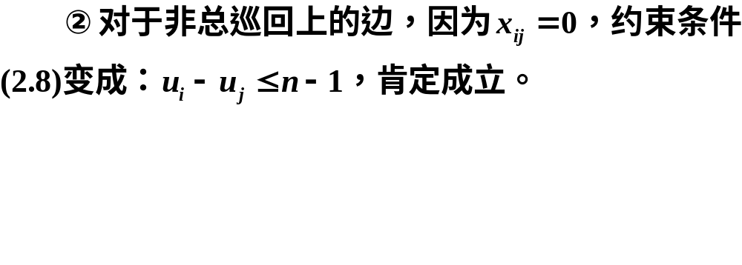

Slide 29
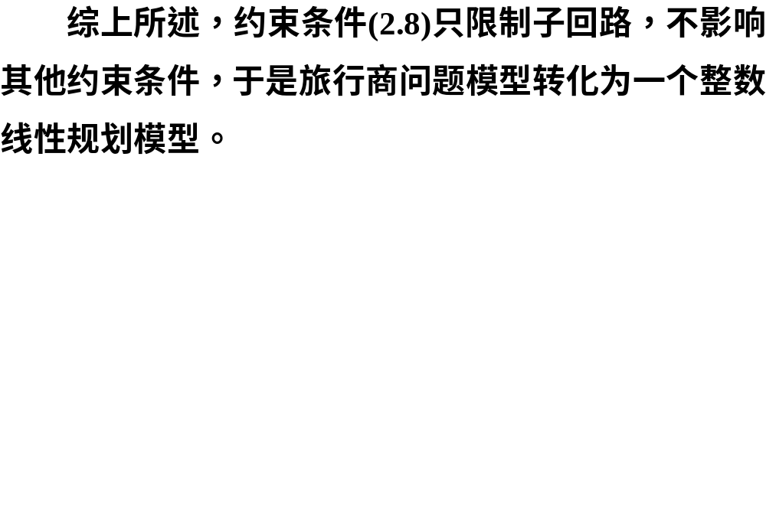

Slide 30
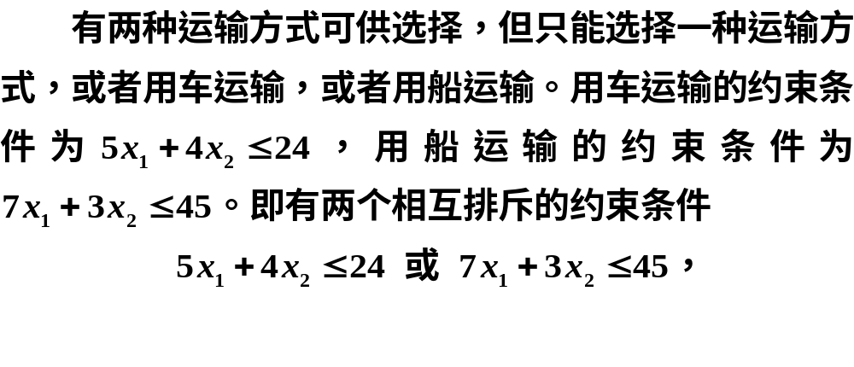
2.1.2 非线性约束条件的线性化
1.相互排斥的约束条件

Slide 31
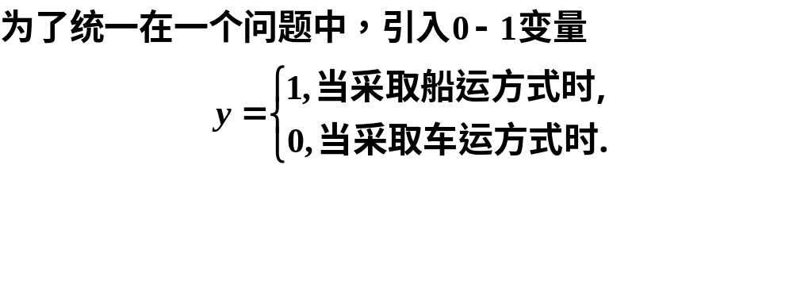
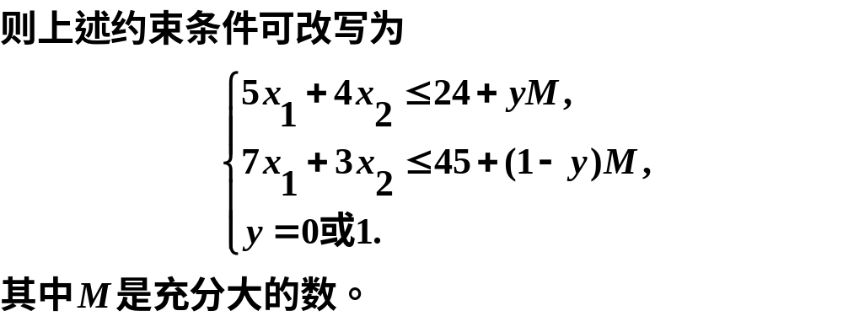

Slide 32
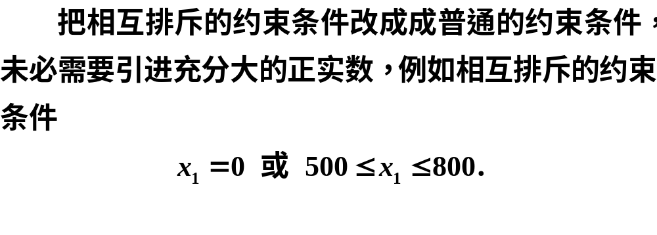
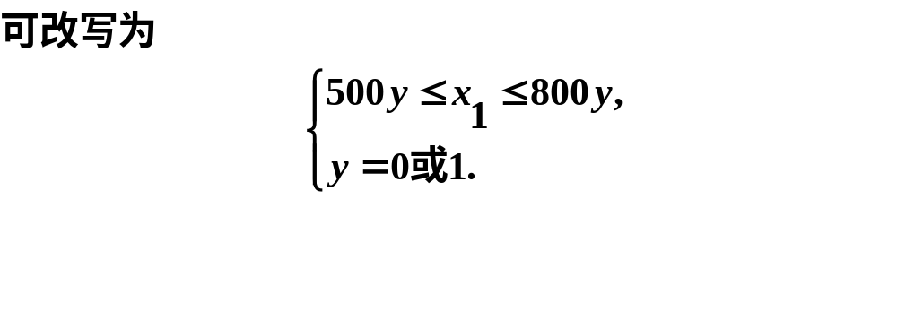

Slide 33
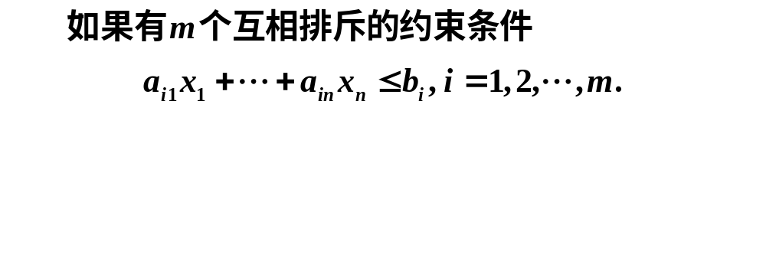
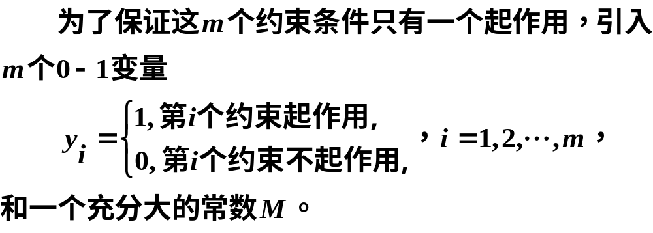

Slide 34
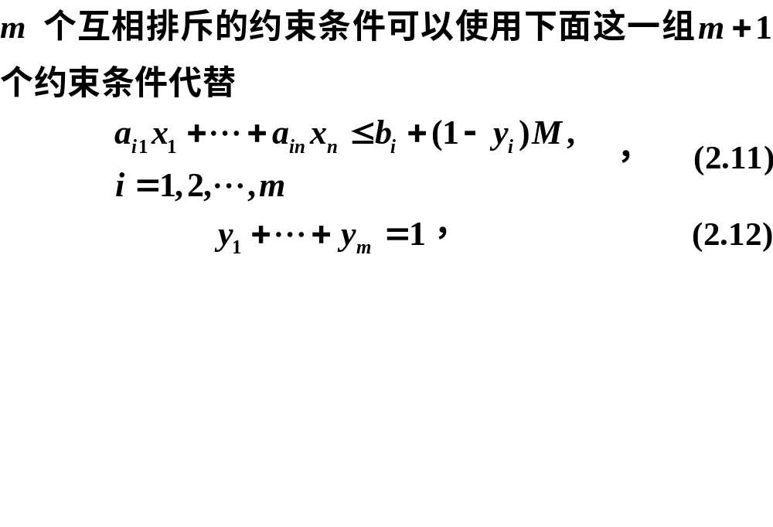

Slide 35
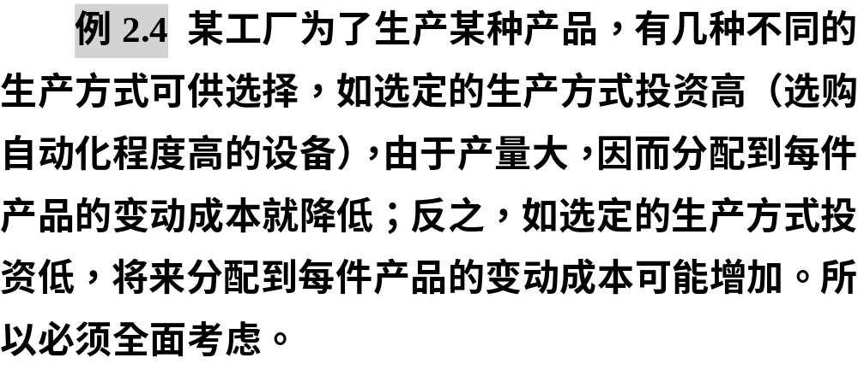
2.固定费用的问题（Fixed Cost Problem）

Slide 36
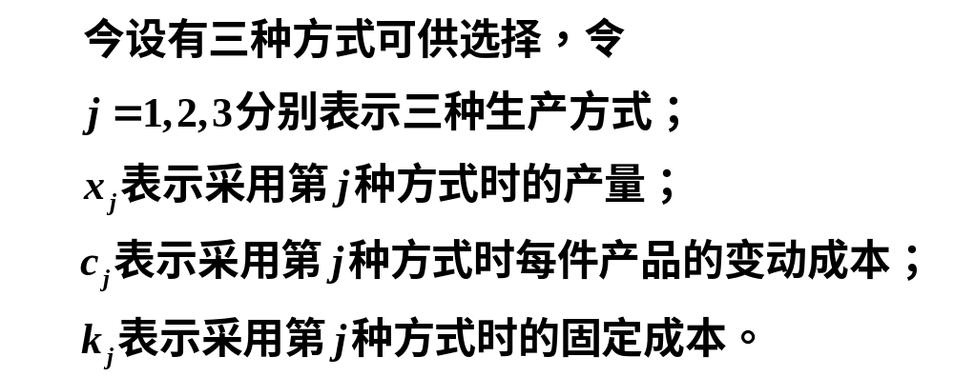

Slide 37
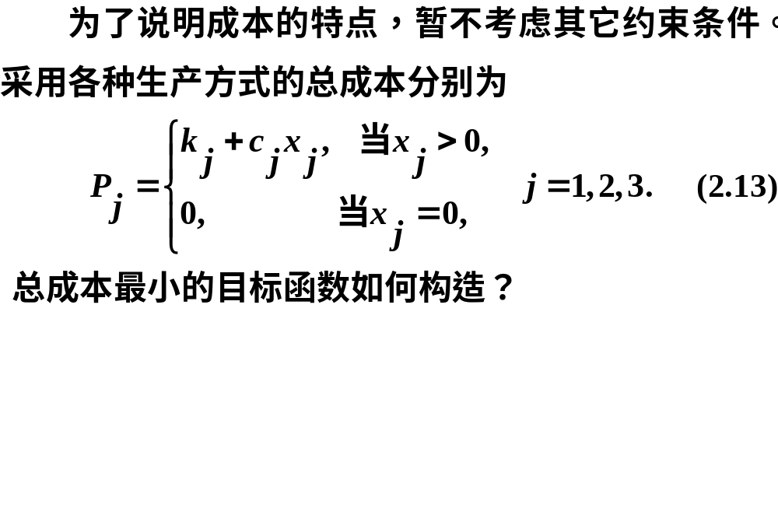
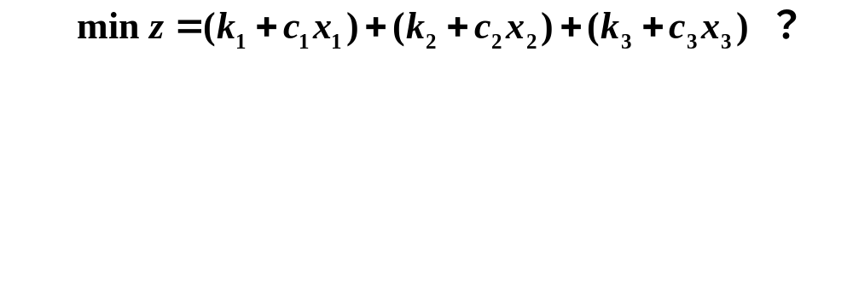


Slide 38
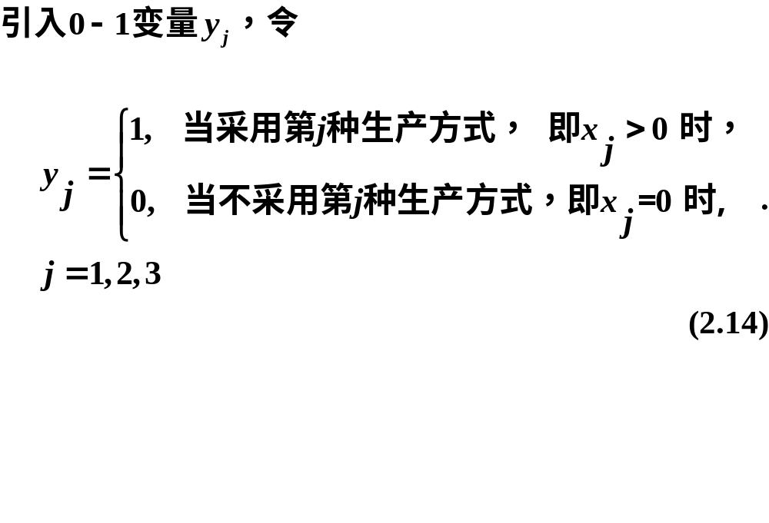

Slide 39
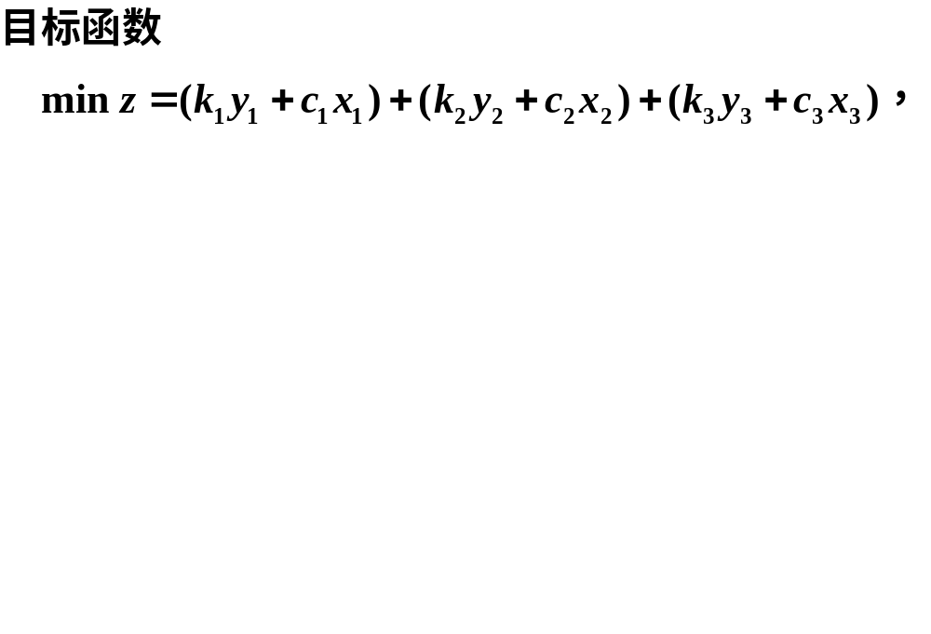
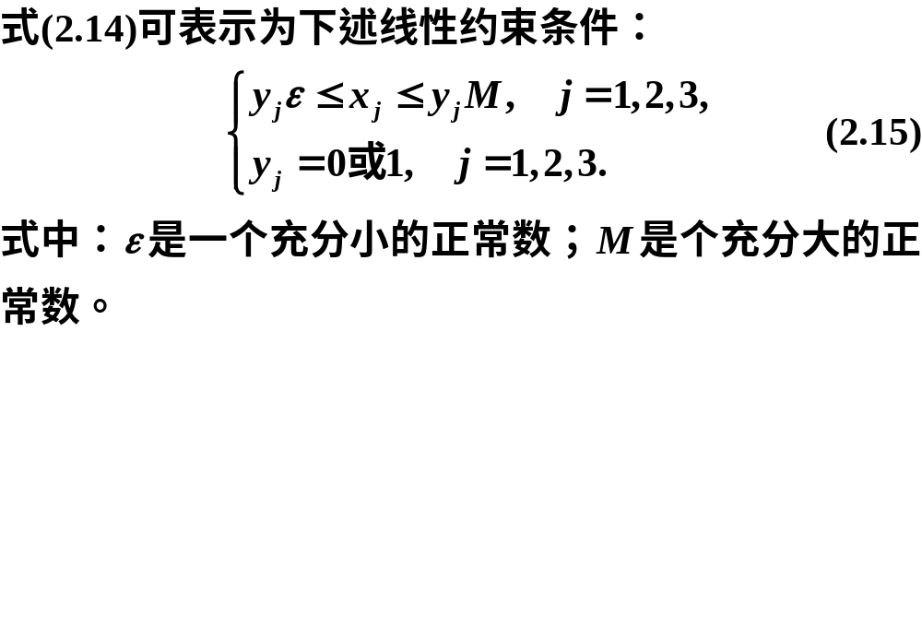
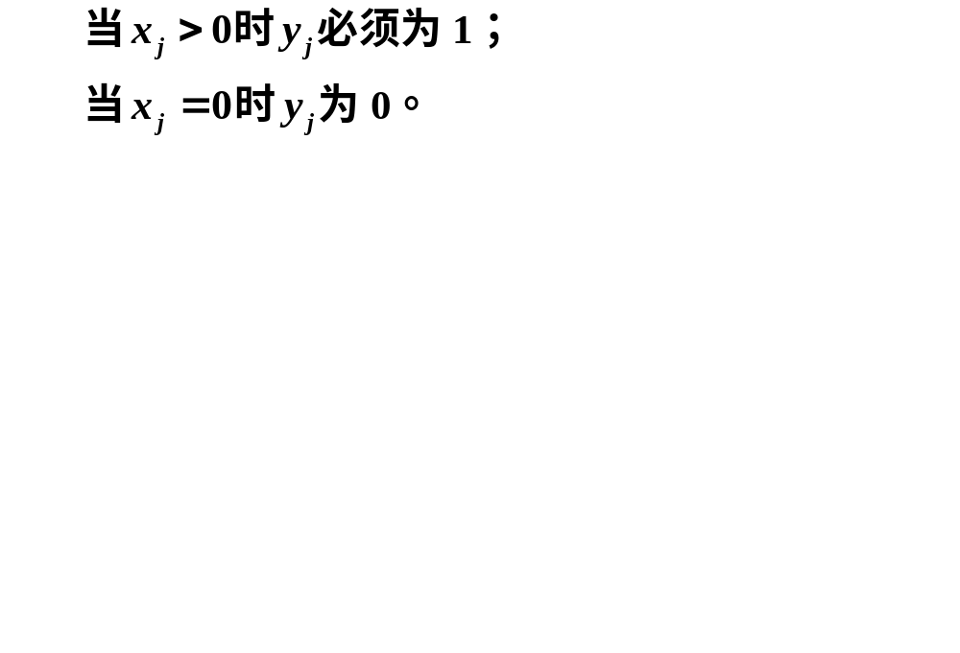

Slide 40
整数规划
模型求解
02

Slide 41
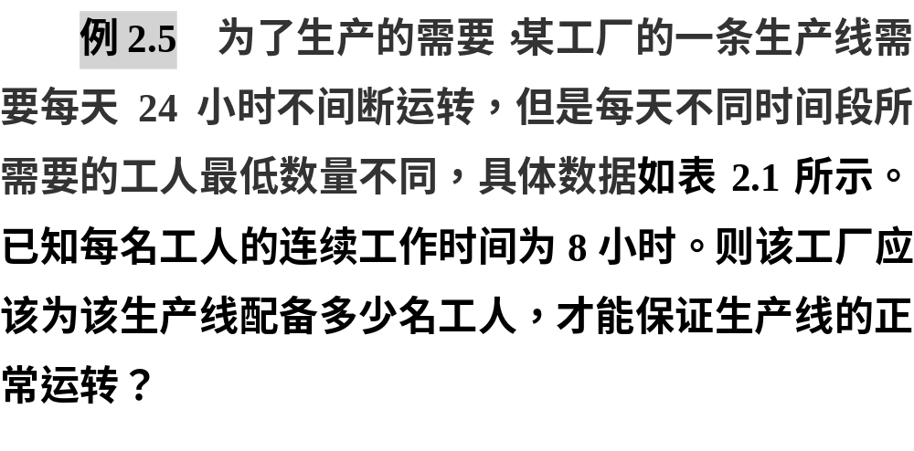
2.2.1 整数线性规划模型求解

Slide 42
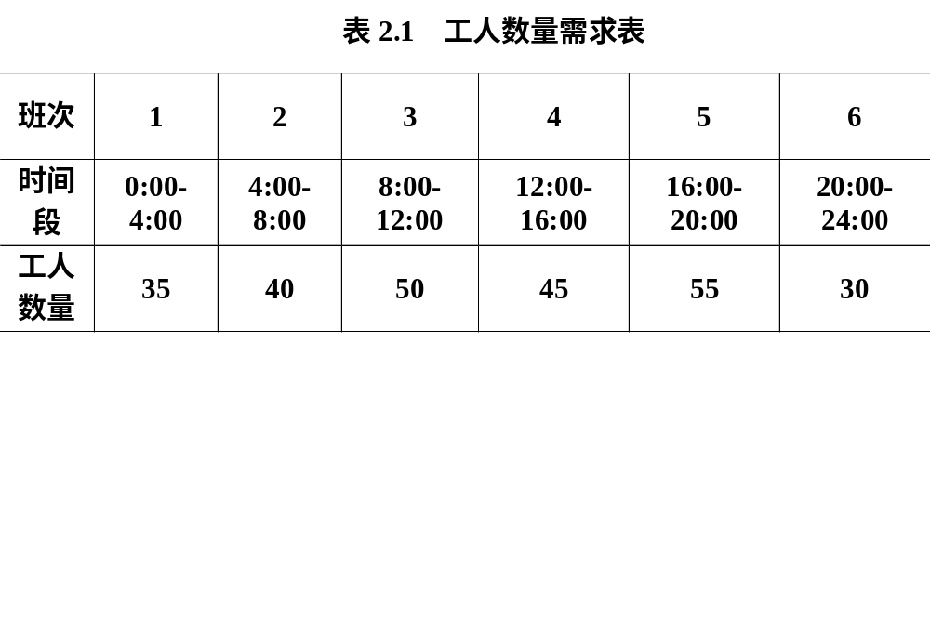

Slide 43


Slide 44



Slide 45


Slide 46


Slide 47


Slide 48
计算的Matlab程序如下：
clc, clear, prob = optimproblem;
x = optimvar('x',6,'Type','integer','LowerBound',0);
prob.Objective = sum(x);
con = optimconstr(6);
a = [35,40,50,45,55,30];
con(1) = x(1)+x(6)>=35;
for i =1 :5
con(i+1) = x(i)+x(i+1)>=a(i+1);
end
prob.Constraints.con = con;
[sol, fval, flag] = solve(prob), sol.x

Slide 49


Slide 50


Slide 51


Slide 52



Slide 53



Slide 54



Slide 55


Slide 56


Slide 57
计算的Matlab程序如下：
clc, clear, c = load('data2_6.txt');
prob = optimproblem;
x = optimvar('x',4,5,'Type','integer','LowerBound',0,'UpperBound',1);
prob.Objective = sum(sum(c.*x));
prob.Constraints.con1 = sum(x,1)==1;
prob.Constraints.con2 = sum(x,2)<=2;
[sol, fval, flag] = solve(prob), sol.x

Slide 58


Slide 59


Slide 60



Slide 61




约束条件

Slide 62


Slide 63


Slide 64
计算的MATLAB程序如下：
clc, clear, a = load('data2_7.txt');
d = dist(a) %求两两列向量之间的距离
n=10; prob = optimproblem;
x = optimvar('x',n,'Type','integer','LowerBound',0,'UpperBound',1)
y = optimvar('y',n,n,'Type','integer','LowerBound',0,'UpperBound',1);
prob.Objective = sum(x);
con1 = [1<=sum(y)'; sum(y,2)<=5]; con2 = [];
for i = 1:n
con2 = [con2; x(i)==y(i,i)];
for j = 1:n
con1=[con1; d(i,j)*y(i,j)<=10*x(i); y(i,j)<=x(i)];
end
end
prob.Constraints.con1 = con1;
prob.Constraints.con2 = con2;
[sol, fval, flag] = solve(prob)
xx = sol.x, yy = sol.y

Slide 65

2.2.2 蒙特卡洛法

Slide 66



Slide 67


Slide 68

计算的MATLAB程序如下：
clc, clear, n=10^7;
x=unifrnd(0,12,[1,n]); y=unifrnd(0,9,[1,n]);
pinshu=sum(y<x.^2 & x<=3)+sum(y<12-x & x>=3);
area_appr=12*9*pinshu/n

Slide 69



Slide 70


Slide 71

这种方法可信吗？

Slide 72




Slide 73


Slide 74
计算的MATLAB程序如下：
clc, clear
%rng('shuffle') %根据当前时间为随机数生成器提供种子
rng(0) %进行一致性比较，每次产生的随机数是一样的
p0=0; n=10^6; tic %计时开始
for i=1:n
x=randi([0,99],1,5); %产生一行五列的区间[0,99]上的随机整数
[f,g]=mengte(x);
if all(g<=0)
if p0<f
x0=x; p0=f; %记录下当前较好的解
end
end
end
x0, p0, toc %计时结束
function [f,g]=mengte(x); %定义目标函数和约束条件
f=x(1)^2+x(2)^2+3*x(3)^2+4*x(4)^2+2*x(5)-8*x(1)-2*x(2)-3*x(3)-...
x(4)-2*x(5);
g=[sum(x)-400
x(1)+2*x(2)+2*x(3)+x(4)+6*x(5)-800
2*x(1)+x(2)+6*x(3)-200
x(3)+x(4)+5*x(5)-200];
end

Slide 75


Slide 76
model:
sets:
row/1..4/:b;
col/1..5/:c1,c2,x;
link(row,col):a;
endsets
data:
c1=1,1,3,4,2;
c2=-8,-2,-3,-1,-2;
a=1 1 1 1 1
1 2 2 1 6
2 1 6 0 0
0 0 1 1 5;
b=400,800,200,200;
enddata
max=@sum(col:c1*x^2+c2*x);
@for(row(i):@sum(col(j):a(i,j)*x(j))<b(i));
@for(col:@gin(x));
@for(col:@bnd(0,x,99));
end

Slide 77
比赛项目
排序问题
03

Slide 78


Slide 79


Slide 80


Slide 81


Slide 82


Slide 83


Slide 84


Slide 85


Slide 86


Slide 87


Slide 88


Slide 89
clc, clear, a = importdata('data2_10.xlsx');
a(isnan(a))=0; %把不确定值NaN替换为0
M=10^7; w=ones(14)*M;
for i=1:14
for j=1:14
if i~=j, w(i,j)=sum(a(:,i).*a(:,j)); end
end
end
n=15; w(n,n)=M; prob=optimproblem;
x=optimvar('x',n,n,'Type','integer','LowerBound',0,'UpperBound',1);
u=optimvar('u',n,'LowerBound',0) %序号变量
prob.Objective=sum(sum(w.*x));
prob.Constraints.con1=[sum(x,2)==1; sum(x,1)'==1; u(1)==0];
con2 = [1<=u(2:end); u(2:end)<=14];
for i=1:n
for j=2:n
con2 =[con2; u(i)-u(j)+n*x(i,j)<=n-1];
end
end
prob.Constraints.con2 = con2;
[sol, fval, flag]=solve(prob)
xx=sol.x; [i,j]=find(xx);
fprintf('xij=1对应的行列位置如下：\n')
ij=[i'; j']

